Slide 1
Computers
Are machines that follow instructions and process data

Slide 2
Think of something that can be done by following a set of rules or steps
For example: tying shoe laces, getting from the school canteen to the library, building a wall in Minecraft, or buying a drink from a vending machine

Slide 3
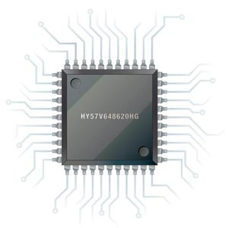
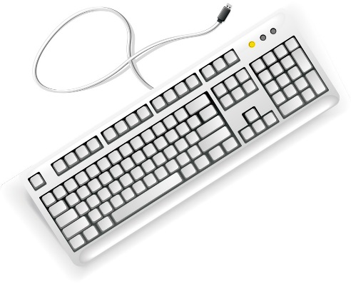

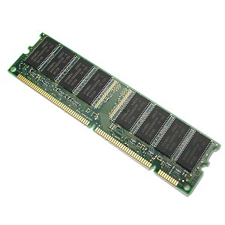
INPUT
PROCESS
OUTPUT
MEMORY
Notes:
Recap that we learnt that a computer was a machine that followed instructions. Instructions and data are stored in the computer’s memory.

Slide 4


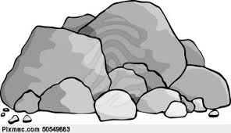






Instructions and data
Tugboat instruction set
forward(steps)
turn_right(angle)
turn_left(angle)
Tugboat’s memory
________________ ________________ ________________ ________________ ________________________________ ________________ ________________ ________________ ________________ ________________ ________________ ________________ ________________ ________________
Notes:
Point out: tugboat, island, rocks, crab, whirlpool, the house.
Refer students to the instruction set. Emphasise that the instructions go in the tugboat’s memory.
Discuss the angles through which the tug can turn, and agree on the direction it is facing to start with.

Slide 5
Tugboat instructions
Write a list of instructions that would guide the boat:
past the island
pick up the crab
drop it off at the house
(Avoid rocks and the whirlpool. You can only use the instructions in the boat’s Instruction Set.)
Bonus
What route takes the shortest number of instructions?
What route covers the shortest distance across the sea?
The memory contains instructions and data. Explain the difference between the two.

Slide 6
Flow charts
start
Flow charts have a start and an end that has a rounded shape.
Processes (individual steps) are in rectangles.
Task
Draw a flow chart for one of the tug boat routes you just worked out
forward(4)
turn_right(90)
forward(2)
end
Notes:
Note: there will likely be a lot of repetition in their flowcharts. Draw this out later when decisions are introduced to look at the notion of efficiency.

Slide 7
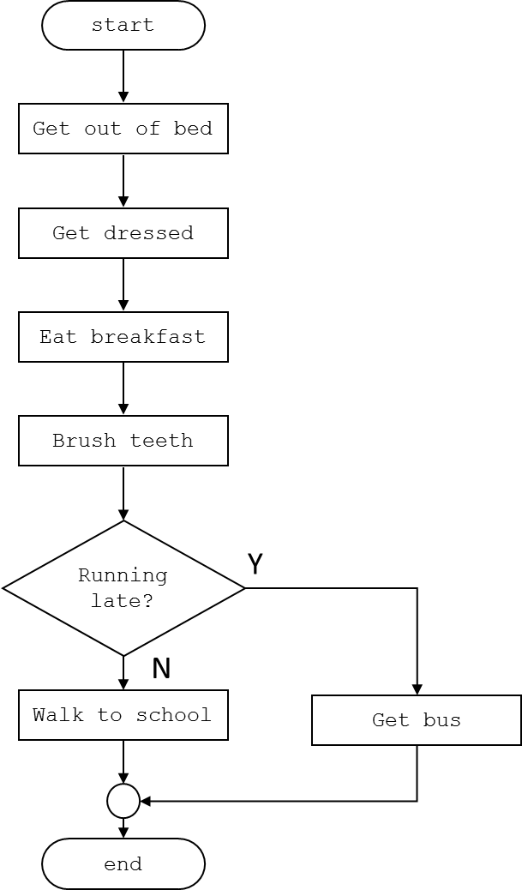
Look at this flow chart
Choose the left or right hand side. The right hand side is more challenging
Complete this flowchart
start
Here’s a flowchart for the sandwich bar. You can choose a wrap or a baguette. You then choose your fillings.
What does it describe?
What new shape is there? What does this new shape do?
What else is new about this flow chart?
Wrap?
N
Y
Copy the flowchart neatly into your books and fill in the blank shapes from the list below.
Task
Make a flow chart for:
You go to the canteen
You choose a hot meal or pasta
You choose a veggie or a meat option if a hot meal
You choose a tomato or pesto option if having pasta
You pay
The end
List for blanks shapes
Pay
Get wrap
end
Choose fillings
Get sub
Wait in queue
Notes:
The decision shape is new. Draw out an understanding of how this works through questioning. Point out the decision through questioning and give examples of decisions that computers make (through comparisons). Remind students that computers are machines so they don’t make emotional decisions: they should give the same response for the same inputs. Also emphasis that the decision should be phrased so that the answer is either yes or no — i.e. there are only two possible outcomes. No other shape has two arrows coming out of it.

Slide 8
Algorithms
Flow charts and the instructions for the tug boat are examples of algorithms.
An algorithm is a set of steps or rules that do something or solve a problem.
Flow charts and computer programs are examples of algorithms.

Slide 9
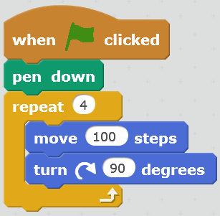
What does this algorithm do?

Slide 11
Old slides

Slide 12
Look at this flow chart
Hand out
start
Get out of bed
What does it describe?
What new shape is there? What does this new shape do?
What else is new about this flow chart?
Task
Make a flow chart for:
You go to the canteen
You choose a hot meal or pasta
You choose a veggie or a meat option if a hot meal
You choose a tomato or pesto option if having pasta
You pay
The end
Get dressed
Eat breakfast
Brush teeth
Running late?
Y
N
Walk to school
Get bus
end

